Slide 1

SE-3002 Software quality engineering
SQA Plan and Development Plan
Overview and Basics
Lecture # 7, 8

Slide 2
Today’s Outline
Development and Quality plan
Notes:
https://classroom.google.com/u/1/c/Mjc1MTg1NDU1MDla

Slide 3
Introduction
Project managers prepare
development and
quality plans
Arduous task,
Senior level management on one end and
Developers on the other

Slide 4
Introduction…
We have proposal plans and internal documents. Enough? No!
These plans typically included time tables, estimates, staffing requirements, scheduled reviews, risks and more.

Slide 5
Introduction…
Development and quality standards (ISO 9000.3 and CMM) require viable plans.
We need to look at development plans and quality plans – their objectives and elements.
They are related but NOT the same.
Notes:
Many times quality plans simply do not occur!

Slide 6
Introduction…
The project needs development and quality plans that:
Are based on proposal materials that have been re-examined and thoroughly updated.
Are more comprehensive than the approved proposal, especially with respect to schedules, resource estimates, and development risk evaluations.
Were prepared at the beginning of the project to sound alerts regarding scheduling difficulties, potential staff shortages, scarcity of development facilities, problems with meeting contractual milestones, modified development risks, and so on.
Notes:
Include additional subjects, absent from the approved proposal.

Slide 7
Development and Quality plan Objectives:
Scheduling development activities, that lead successful timely completion of the project.
Recruiting team members and allocating development resources.
Resolving development risks.
Implementing required SQA activities

Slide 8
Software Quality Assurance Plan
Abbreviated as SQAP, the software quality assurance plan comprises of:
The procedures, techniques, and tools that are employed to make sure that a product or service aligns with the requirements defined in the SRS.
The plan identifies the SQA responsibilities of a team, lists the areas that need to be reviewed and audited.

Slide 9
SQA Activities
Prepares an SQA plan for a project
The plan is developed during project planning and is reviewed by all interested parties. Quality assurance activities performed by the software engineering team and the SQA group are governed by the plan.
The plan identifies many important aspects of QA summarized below:
Evaluations to be performed
Audits and reviews to be performed
Standards that are applicable to the project
Procedures for error reporting and tracking
Documents to be produced by the SQA group
Amount of feedback provided to software project team

Slide 10
Elements of Quality Plan
List of quality goals
Reviews and audits
Testing
Error/defect collection and analysis
Configuration management
Educational programs

Slide 11
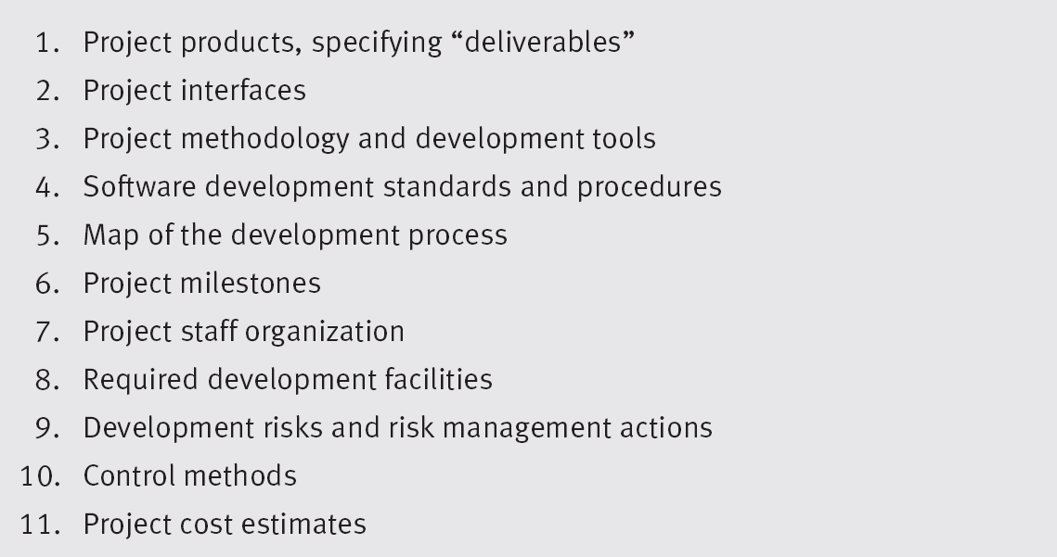
Elements of the Development Plan

Slide 12
Elements of the Development Plan
Project Products, specifying “Deliverables”
Must specify items to be delivered to customer
documents, user manuals
Must specify specific software products (along with completion and installation dates

Slide 13
No. | Deliverables | Media | QTY | Dates
1 | Proposal | Hardcopy | 4 | 14 September 2022
2 | SRS | Hardcopy | 2 | 24 September 2022
3 | Acceptance Test Report | Hardcopy | 3 | 26 September 2022
4 | Software | DVD | 30 | 30 September 2022

Slide 14
Elements of the Development Plan
Project Interfaces
Interfaces with existing software packages (software interface)
Interfaces with other software

Slide 15
Elements of the Development Plan
Project methodology and development tools
Waterfall
Agile
V-model so forth.
Hardware AND SOFTWARE TOOLS
Management tools
Software Development Standards and Procedures
ISO
CMMI
WBS

Slide 16
Elements of the Development Plan
Map of the Development Process
Detailed definition of project’s phases:
Estimates of each activity’s duration:
Sequencing and dependency of activities.
List of professional resources needed overall and for each activity.

Slide 17
Elements of the Development Plan
Can use PERT and CPM and other activities to communicate activities, durations, deliverable dates, …
Some like Microsoft Project.
Can use more modern tools too, like IBM’s Rational Team Concert (RTC).

Slide 18
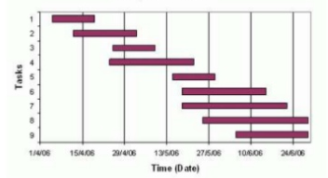
Gantt Chart

Slide 19
Elements of the Development Plan…
Project Milestones
Completion time with project products

Slide 20
Elements of the Development Plan
Project staff organization and coordination with external participants
Organizational structure
Professional requirements
Number of team members
Long term leadership; team losses due to many factors;
Notes:
Often these responsibilities are ‘shredded out’ too

Slide 21
Elements of the Development Plan
Required development facilities
Required hardware, software, tools, office space, infrastructure
Development Risks and Risk Management Actions
Technology Risks – lack of expertise; not correct / needed tools
Environmental Risk:
Interdependence of other organizational elements who supply resources (subcontractors, specialized hardware, etc. )
Notes:
Is it an app for the battlefield? Home?

Slide 22
Elements of the Development Plan
Control methods
Progress reports and coordination meetings are planned to control project implementation
Project Cost Estimates
These are based on proposal cost estimates followed by thorough review and continuous updating.
Changes can/will occur and these can be major budget impacts, such as subcontractors don’t fulfill their obligations or other unplanned expenditures arise.
Some projects are ‘successes’ but way over budget.
Ultimately, the approval of the development plan will take place within the organization(s).

Slide 23
References
Software Quality Assurance: from Theory to Implementation. Daniel Galin, Chapter 6, Pearson Education, 2004.

Slide 24
Concluding remarks
SQA is an umbrella activity which is employed throughout the software lifecycle.
Software quality assurance is very important for your software product or service to succeed in the market and survive up to the customer’s expectations.
There are various activities, standards, and techniques that you need to follow to assure that the deliverable software is of high quality and aligns closely with the business needs

Slide 25
That is all

